Slide 1
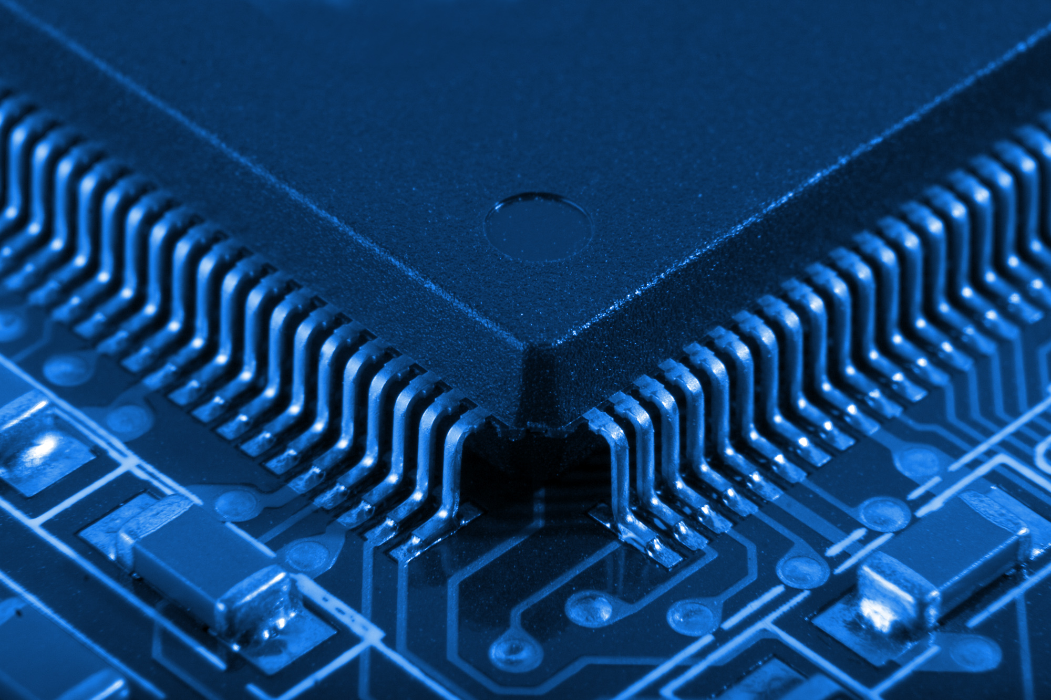
FPGA Design Challenge :Techkriti’14 Digital Design using Verilog – Part 2
Anurag Dwivedi

Slide 2
Recap
Verilog- Hardware Description Language
Modules
Combinational circuits
assign statement
Control statements
Sequential circuits
always@ block
Blocking and non-blocking statements

Slide 3
Modular Circuits
Time to construct larger modules from smaller modules.
Various modules are interconnected to make a larger circuit (or module).
Each sub-module has a separate Verilog file.
A sub-module may have another sub-module in its circuit.
One needs to indicate the top level module before synthesis.

Slide 4
Example
Sub-module 1
module Sub1 (input wire [7:0] a1, output wire [7:0] b1);
Sub-module 2
module Sub2 (input wire [7:0] a2, output wire[7:0] b2);
Top Module
Module Top (input wire [7:0] a, output wire[7:0] b);

Slide 5
Instantiation
Used to create instances of the module and create connections among different modules.
In the above example, we need to instantiate the two sub-level modules in the top module.
This is done as follows:
wire [7:0] c;
Sub1 Encoder (.a1(a), .b1(c));
Sub2 Decoder (.a2(c), .b2(b));

Slide 6
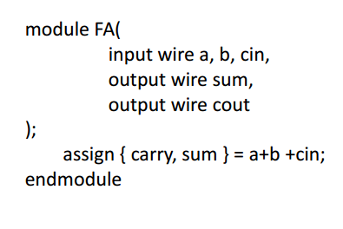
Example : Full Adder
module FAdder(
input wire [3:0] A, B,
output wire cout,
output wire [3:0] S );
wire c0, c1, c2;
FA fa0( .a(A[0]), .b(B[0]), .cin(0),.cout(c0), .sum(S[0]));
FA fa1( .a(A[1]), .b(B[1]), .cin(c0), .cout(c1), .sum(S[1]));
FA fa2( .a(A[2]), .b(B[2]), .cin(c1), .cout(c2), .sum(S[2]));
FA fa3( .a(A[3]), .b(B[3]), .cin(c2), .cout(cout), .sum(S[3]));
endmodule

Slide 7
Points to note
All output ports of instantiated sub-module should be of wire data-type.
Note in previous example, c0,c1,c2 and S are wires.
Inputs may be reg or wire.
Suppose in above, [3:0] S was of reg type.
Declare a dummy wire variable [3:0] add
Pass add[0], add[1] … to the instantiations
Finally put:
always@(*)
S <= add;

Slide 8
Parameterized Modules
A generalized type of module.
Can be instantiated to any value of parameter.
Parameterization is a good practice for reusable modules
Useful in large circuits.

Slide 9
N-Bit adder
module AdderN #(parameter N = 4)(
input wire [N-1:0] IN1,
input wire [N-1:0] IN2,
output reg [N-1:0] OUT );
always @(*)
OUT <= IN1 + IN2;
endmodule

Slide 10
Instantiation of Parameterized Modules
<Module Name> #(.<Parameter Name>(value)) <Instance name>
( .IN1(…) , .IN2(…), .OUT1(…), .OUT2(…) );
Example :
AdderN # ( .N(16) ) Add16 ( .IN1(in1), .IN2(in2), .OUT(out) );

Slide 11
Test Bench
Used to test the functionality of design by simulation.
Instantiate our top most module and give varying inputs & verify if the outputs match expected results.
Added functionalities in Test Bench:
Delays
$display(), $monitor()

Slide 12
Delays
Not synthesized
Can be used to model delays in actual circuit during simulation
Used mostly in Test Benches to provide inputs at particular instants.
Syntax: #<time steps>
#10 q = x + y; // inter assignment delay
q = #10 x + y; // intra assignment delay
Most common:
always
#5 clk = ~clk;

Slide 13
More features
$display()
used for printing text or variables to screen
syntax is the same as for printf in C
$display("time, \tclk, \tenable, \tcount");
$monitor()
keeps track of changes to the variables in the list
whenever any of them changes, it prints all the values
only written once in initial block.
$monitor("%d,\t%b,\t%b,\t%b,\t%d",$time, clk, enable,count);
$finish
Terminating simulation

Slide 14
Test Bench Counter
module counter_tb;
reg clk, reset, enable;
wire [3:0] count;
counter C0( .clk (clk), .reset (reset), .enable (enable), .count (count) );
initial begin
clk = 0;
reset = 0;
enable = 0;
end
always
#5 clk = !clk;
initial begin
$display("time,\tclk,\tenable,\tcount");
$monitor("%d,\t%b,\t%b,\t%d",$time, clk,enable,count);
end
initial
#100 $finish;
endmodule

Slide 15
Demonstration
4029 Counter
4-bit Full Adder

Slide 16
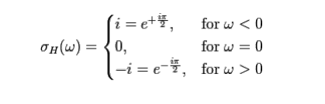
FPGA Design Challenge Techkriti’14
Problem Statement :
The challenge in FPGA is to design and efficiently implement the Hilbert transformation of any given function.
It maps a time domain function to another time domain function by a convolution of the input signal with the function H(t) whose representation in frequency domain is:
Frequency domain representation of Hilbert Transform

Slide 17

Fourier Transform
FT is a mathematical transformation to transform a signal from time domain to frequency domain.

Slide 18
Basic Theory
If x(t) is our signal and h(t) is the signal corresponding to Hilbert Transform, then the Hilbert transform of x(t), hx(t) = x(t)*h(t)
FT(hx(t)) = FT(x(t)*h(t)) = X(f) x H(f)
Here, X(f) is the Fourier transform of x(t) and H(f) is the Fourier Transform of h(t) given by
hx(t) = IFT( X(f) x H(f) )

Slide 19
Basic Theory
Find Fourier Transform of the function.
Multiply the FT by H(f)
Apply inverse Fourier Transform of the function obtained.

Slide 20
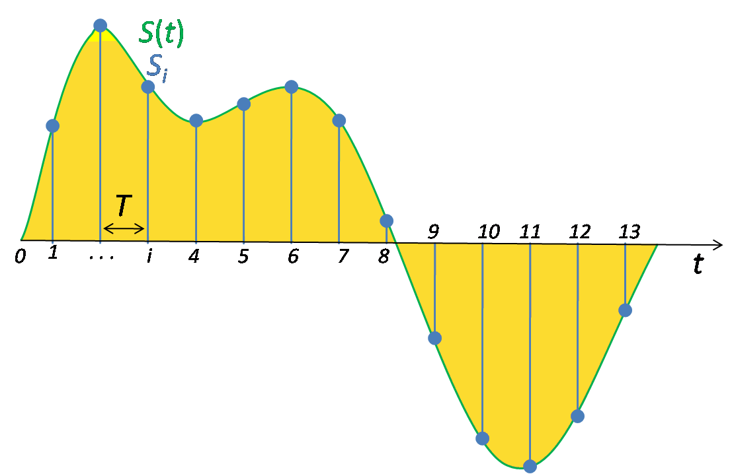



Discrete Fourier Transform
How to model continuous time signals in our digital hardware?
Work with samples of signal
xi[n] = x (nT) ; n = 0,1 … N-1
T is the sampling period
How to take Fourier transform?
Take Discrete Fourier Transform

Slide 21
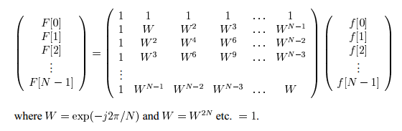
DFT Matrix
Total number of operations : O(N^2)

Slide 22
Fast Fourier Transform
Computation of DFT involves a lot of redundant operations
Time complexity can be reduced drastically by using this information
A class of algorithms known as Fast Fourier Transform (FFT) is developed for the same

Slide 23



Cooley–Tukey algorithm : Radix 2 case
When N is a factor of 2
We have
Writing the odd and even numbered terms separately
Taking out the common factor

Slide 24


Cooley–Tukey algorithm : Radix 2 case
Because of Periodicity of DFT we have
Finally,

Slide 25
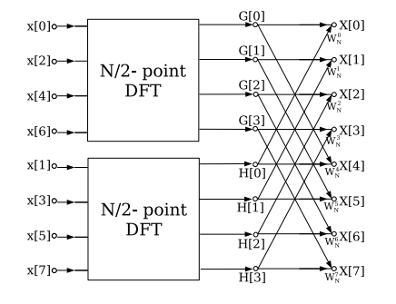

Slide 26
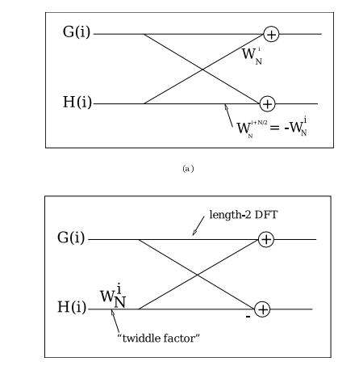
Further reduction in computation

Slide 27
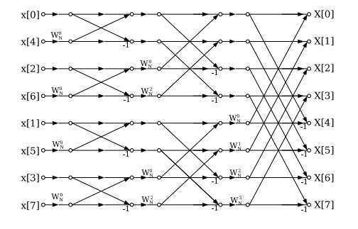
Complete Structure
O(N log(N))

Slide 28
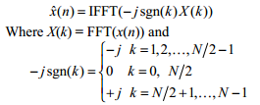
Basic Theory
To implement Hilbert transform in Verilog
Find FFT of sequence
Multiply it by –j sgn(k)
Take IFFT of the resulting sequence

Slide 29
Note
The approach mentioned above is one of the many possible solutions to the problem statement.
You should search more and look for better solutions.

Slide 30
Judging criteria
Area (#LUTs, #FFs, #BRAMs, #DSP Elements etc.)
Latency (No. of cycles Reqd).
Need for external memory (eg. DRAM Controller – DDR/DDR2 and size of memory required).
Maximum frequency achieved.
Power consumption as reported by ISE tool.
Extra Feature : Implementation of a feature where Hilbert transform is being used

